Slide 1
Cold Email Generator using LLaMA3
AI-Powered Personalization for Outreach and Job Applications
Presented by: Syed Amanat Ali Shah

Slide 2

The Problem with Cold Emails
Cold emails often feel robotic and generic
Low response and engagement rates
Writing personalized emails for each job/contact is time-consuming

Slide 3
My Solution — Cold Email Generator
An AI-powered tool that generates personalized cold emails using job details and skills — built using Meta's LLaMA 3-70B model.
Features: .Auto-skims job descriptions .Matches with your portfolio .Crafts context-rich, personalized emails

Slide 4

Tech Stack
🧠 LLaMA 3-70B (via HuggingFace/Ollama) 🔗 LangChain (Prompt Chaining, Memory) 🌐 Streamlit (Web UI) 🐍 Python (Core logic) 📂 Pandas (Job data handling) 🛠️ GitHub (Version Control)

Slide 5
How It Works (Architecture)
Job Description
Extract Skills → Match with Portfolio
Prompt LLaMA 3 (Input = job + links)
Email Draft (LLM Output)
Display in Streamlit

Slide 6

Prompt Engineering
Combined job role + required skills + matching projects
Used Markdown formatting for cleaner output
Few-shot learning optionally used for tone setting
Kept prompt within 8192-token limit

Slide 7
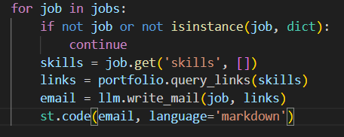
Code Example (Main Loop)

Slide 8

Output Example
🧾 Job: Software Engineer III - Unreal Engine, ITC 🛠️ Skills: React, TypeScript, REST APIs, Machine Learning
Projects:
Real Estate Dashboard (React)
Crypto Donation App (REST APIs)
AI Chatbot Dialogflow

Slide 9
Generated Email (Excerpt):
Subject: Excited to Apply for Software Engineer III Unreal Engine ITC Role
Dear [Manager's Name],
I came across the job description for the Software Engineer III Unreal Engine ITC role and was impressed by the opportunity to drive technical vision and strategy for configurator and product visualization initiatives. With my expertise in Unreal Engine and 5+ years of experience in 3D pipeline development and tool creation, I believe I would be an excellent fit for this position. As a seasoned Software and Machine Learning Engineer, I have a proven track record of empowering enterprises with tailored solutions, fostering scalability, process optimization, cost reduction, and heightened overall efficiency. My proficiency in C programming, Unreal Engine framework, web APIs, asynchronous code, software development best practices, and version control systems (e.g. Git, Perforce) aligns with the requirements of the job.
I'd like to highlight a few projects that demonstrate my capabilities:
* CO2 Emission Prediction Using Random Forest Regressor: A machine learning project that predicts CO2 emissions based on various factors, showcasing my expertise in data analysis and modeling. (https://github.com/Amanat838/CO2-Emission-Prediction-Using-Random-Forest-Regressor)
* Doctor Appointment Web App: A web application that enables users to schedule and manage doctor appointments, demonstrating my skills in web development and user experience. (https://github.com/Amanat838/Doctor-Appointment-Web-App)
I'm excited about the prospect of joining your team and contributing to the success of your configurator and product visualization initiatives. I'd be thrilled to discuss my application and how I can help drive technical vision and strategy for your projects. Please feel free to contact me at your convenience. I look forward to the opportunity to discuss this further.
Best regards,
Amanat

Slide 10
Benefits and Use Cases
Saves hours of manual writing
Increases cold email effectiveness
Tailored to job roles, not templates
Use Cases:
Job Applications
Freelancer Outreach
Sales & Marketing
LinkedIn Networking

Slide 11
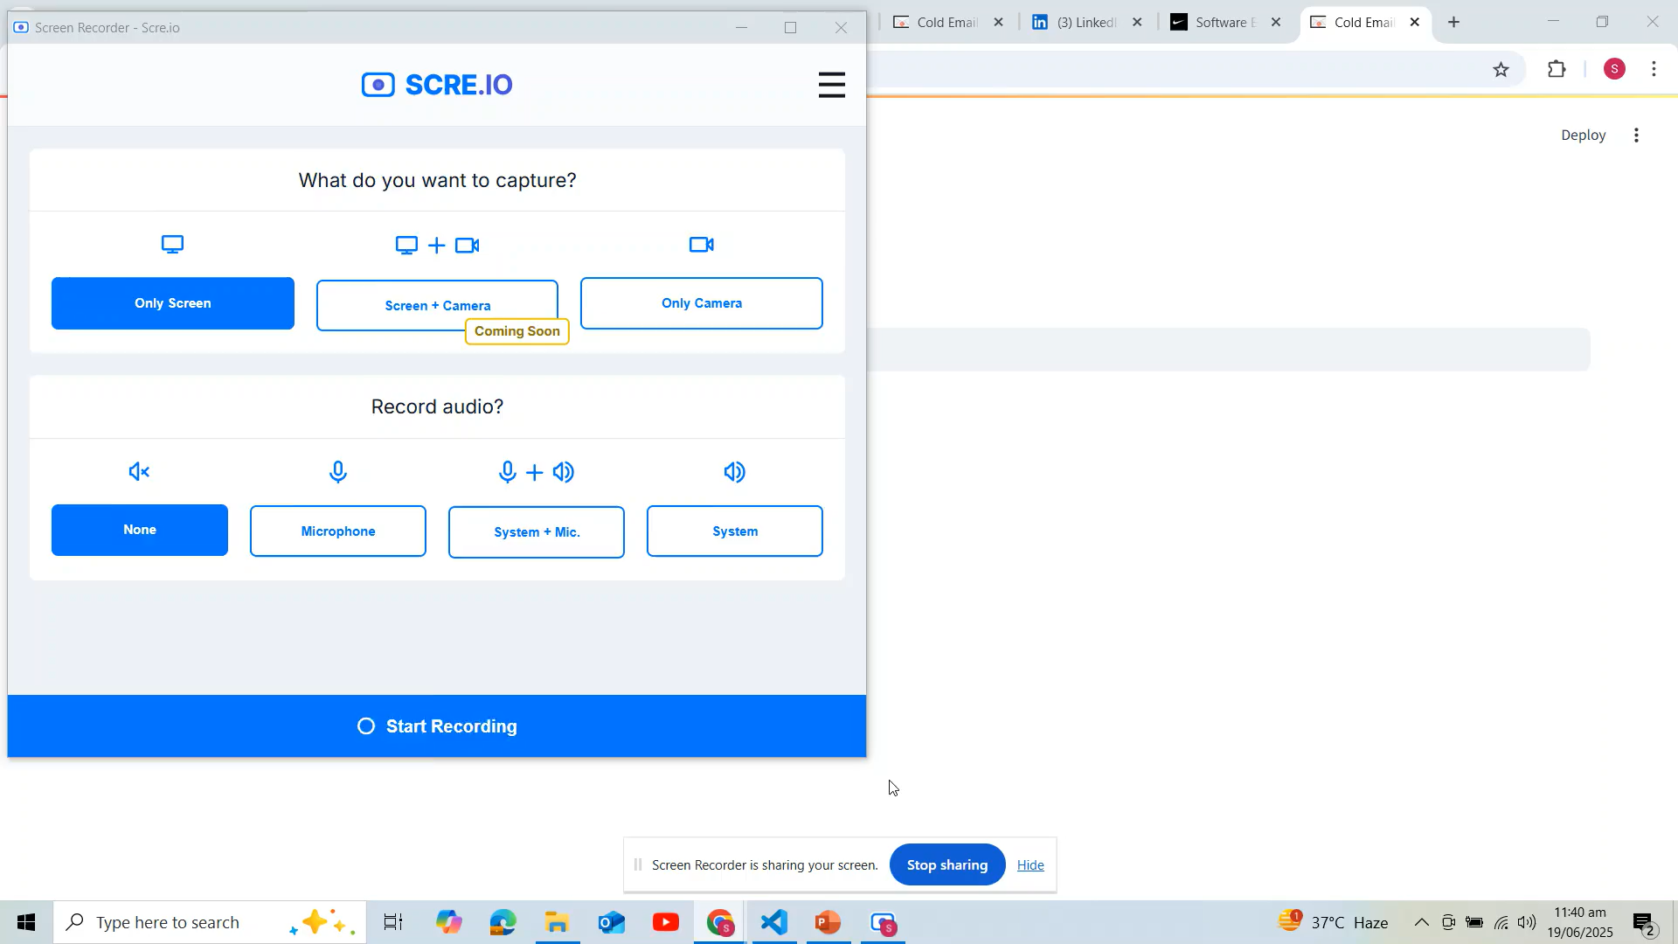
Live Demo

Slide 12
Challenges I Faced
❗ LLaMA model size – setup and performance tuning
❗ Prompt engineering to keep output relevant
❗ Token limit management (8192 cap)
❗ Job descriptions with missing or vague skills

Slide 13
What’s Next?
🔄 Add LinkedIn job scraping
📬 One-click email sending via Gmail/Outlook API
🧠 Auto-learn user preferences over time
📱 Mobile-optimized version (React Native / Flutter)

Slide 14
GitHub & Credits
🔗 GitHub Repo: https://github.com/Amanat838/Cold-Email-Generator-Using-Langchain-and-Llama3-70b-8192
🤖 Powered by:
LLaMA 3 by Meta
LangChain
Streamlit

Slide 15

Thank You!
Questions? Let’s connect! 📧 syedamanatalishahkazmi@gmail.com 💼 LinkedIn: www.linkedin.com/in/amanat-ali-765110264/

